Slide 1
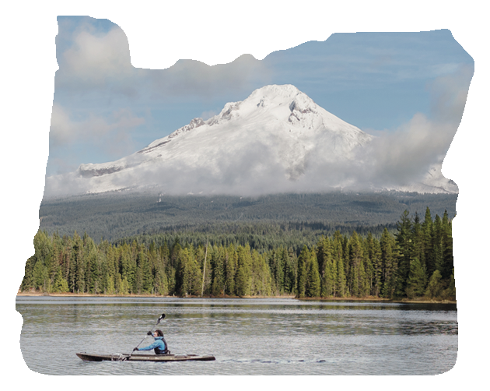
Impacts of Tourism Marketing
PNWER Annual Summit/Tourism Working Group
July 24, 2017

Slide 2
TRAVEL OREGON’S VISION
A better life for Oregonians through strong, sustainable local economies.
TRAVEL OREGON’S MISSION
We inspire travel that drives economic development. Through innovation and partnerships, we share the stories of Oregon’s people and places, ensuring the preservation of Oregon’s way of life and natural places.

Slide 3
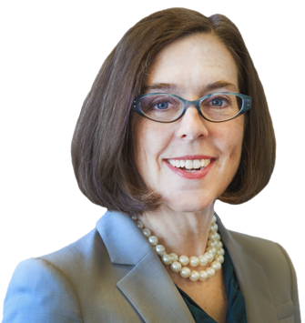
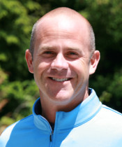
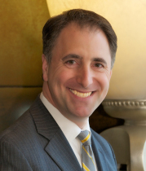
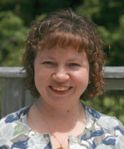
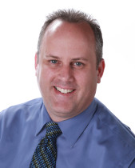
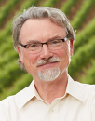
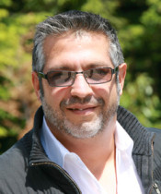
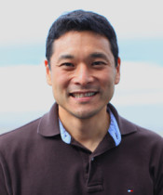
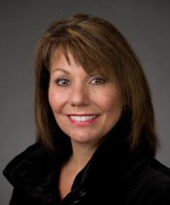
TRAVEL OREGON
ORGANIZATIONAL STRUCTURE
GOVERNOR KATE BROWN
TRAVEL OREGON
Todd Davidson, Chief Executive Officer
OREGON TOURISM COMMISSION
Chair
Ryan Snyder
Vice Chair
Scott Youngblood
Kara
Wilson-Anglin
Don Anway
Richard Boyles
Nigel Francisco
Al Munguia
Kenji Sugahara
Alana Hughson
Notes:
Nine commissioners oversee the Oregon Tourism Commission, and each is appointed by the governor of Oregon
One represents the public-at-large, five represent the lodging sector and three represent the tourism industry-at-large (not including lodging)
Commissioners approve and oversee the commission budget and strategic plan that directs the actions of the professional staff
Todd Davidson was appointed Executive Director of the Oregon Tourism Commission in 1996 and named CEO in 2004.
Travel Oregon has garnered 20 Mercury Awards during Todd’s tenure, including two top awards for Best Overall State Marketing Program in 2010 and 2013. Recent Mercury Awards include: Best State Broadcast Campaign (2016), Best Branding and Integrated Marketing Campaign (2015), Best State International Marketing (2015, 2011 and 2009), Best Co-Op Marketing Plan (2014), Best Travel Website (2013), Best Interactive Marketing Program (2011), Best State Travel Guide (2011) and Best State Tourism Print Advertising (2009). Todd was also honored by the NCSTD as the State Tourism Director of the Year in 2006.
Todd is a past Chair of the U.S. Travel and Tourism Advisory Board, a position he was appointed to in January 2012 after being initially appointed to the Board in 2010. Todd continues to serve on the USTTAB, having been appointed to a fourth term by US Secretary of Commerce Penny Pritzker. Todd also serves as the National Chair of the U.S. Travel Association, and serves on the National Council of State Tourism Directors and the Western States Tourism Policy Council.

Slide 4
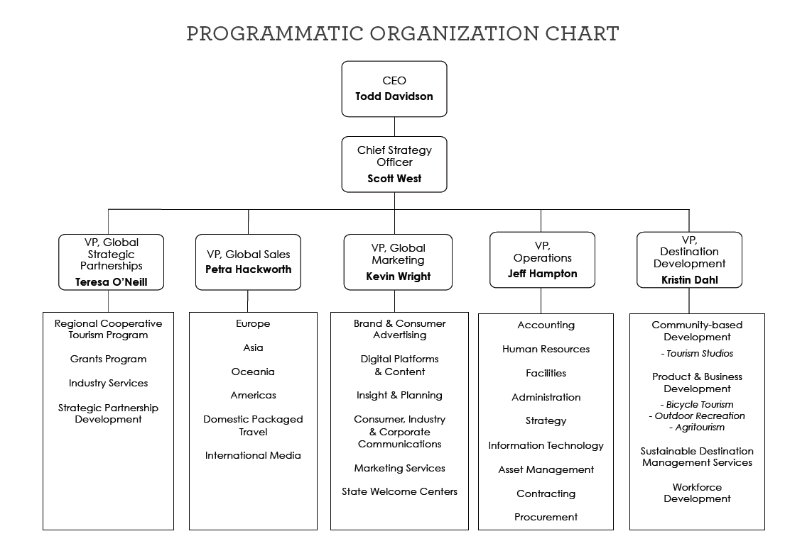

Slide 5
LEGISLATIVE ACTION
2003 LEGISLATION (HB 2267)
Implemented 1% Statewide Lodging Tax to fund Oregon Tourism Commission, dba Travel Oregon
Established Travel Oregon as a semi-independent state agency
Protected local lodging taxes
Existing local rates and allocations for tourism were “grandfathered”
Future increases in local lodging tax rates require at least 70% dedicated to tourism
2016 LEGISLATION (HB 4146)
Increased state lodging tax from 1% to 1.8% effective July 1, 2016 & decreases to 1.5% effective July 2020
Directs 20% of state lodging tax to implement a Regional Cooperative Tourism Program & 10% to a competitive grants program
Notes:
In 2003, Oregon faced one of it’s highest unemployment rates in history. Eager to create new opportunities for Oregonians, the Oregon Tourism Investment Proposal was created, enacted & signed into law. The bill made tourism & hospitality a pillar of Oregon’s economy by reinvesting 1% of lodging revenue back into tourism development and marketing. Lawmakers realized visitors generate significant spending & businesses may look to relocate to Oregon after visiting here. With proper support, they believed tourism could be a powerful tool to bolster the state’s economy.
The increase in economic impact is significant. So much so, that on March 3, 2016, House Bill 4146 was passed, which increased the state transient lodging tax from 1% to 1.8% for 4 years effective July 1, 2016. Effective July 1, 2020, the TLT reduces from 1.8% to 1.5%. The legislation directs 20% of the total collected to a Regional Cooperative Tourism Program, distributing funds to the 7 tourism regions and 10% to a competitive grants program.
HB4146 doesn’t change:
Local tourism funding percentages as determined by HB 2267 – Percentage rate of tourism investment as of July 2, 2003 becomes the floor for contributions to tourism (example: Coos Bay 25% as of July 2, 2003 then Coos Bay must spend a minimum of 25% on tourism today)
Local tourism investment requirement (minimum of 70%) for taxes initiated after July 2, 2003: any new tax generated locally must dedicate a minimum of 70% for local tourism investment
Tourism definitions – no definitions have changed; future investment still driven by definitions currently in statute
FACILITATOR’S NOTE: Why drop from 1.8 to 1.5? The original thought for the increase of state lodging tax was to help fund World Track and Field Championship in 2021. The lodging industry didn’t support an increase just for this one event and Gov wanted the strategy to be more longer-term to support the industry and the economic impact of tourism. The WTFC is not in the statue, however they will writing a proposal most likely for Travel Oregon to help support marketing efforts of the event. This event will be a very large opportunity for Oregon to be on the center stage internationally airing in 200+ countries for 10 days. Will be the largest sporting event in the world in 2021! It’s the 3rd largest event in the world next to Olympics and World Cup. Also, WTFC Teams will be coming to Oregon 1 month prior to WTFC to practice. Some communities like Astoria are already looking to how they could recruit and support the training teams to post up in their communities.
---
DEFINITIONS IF NEEDED:
ORS 320 Definitions of what transient lodging tax is allowable for, if needed:
(6)Tourism means economic activity resulting from tourists.
(7)Tourism promotion means any of the following activities:
(a)Advertising, publicizing or distributing information for the purpose of attracting and welcoming tourists;
(b)Conducting strategic planning and research necessary to stimulate future tourism development;
(c)Operating tourism promotion agencies; and
(d)Marketing special events and festivals designed to attract tourists.
(9)Tourism-related facility means:
(a)A conference center, convention center or visitor information center; and
(b)Other improved real property that has a useful life of 10 or more years and has a substantial purpose of supporting tourism or accommodating tourist activities.
(10)Tourist means a person who, for business, pleasure, recreation or participation in events related to the arts, heritage or culture, travels from the community in which that person is a resident to a different community that is separate, distinct from and unrelated to the persons community of residence, and that trip:
(a)Requires the person to travel more than 50 miles from the community of residence; or
(b)Includes an overnight stay.
(11)Transient lodging means:
(a)Hotel, motel and inn dwelling units that are used for temporary overnight human occupancy;
(b)Spaces used for parking recreational vehicles or erecting tents during periods of human occupancy; or
(c)Houses, cabins, condominiums, apartment units or other dwelling units, or portions of any of these dwelling units, that are used for temporary human occupancy.

Slide 6
OREGON TOURISM PERFORMS
 | In 2003 | In 2016 | Change
Direct Employment | 84,000 jobs | 109,500 jobs | +30%
Employee Earnings | $1.7 billion | $3.1 billion | +82%
Visitor Spending | $6.5 billion | $11.3 billion | +74%
Taxes (State/Local) | $246 million | $507 million | +106%
Source: Oregon Travel Impacts, Dean Runyan Associates, 2017
Notes:
Since implementation of Oregon’s tourism investment strategy (HB 2267) – with the work of Travel Oregon and industry partners, private businesses, etc. – the economic impacts from the overnight visitors has exceeded expectations. These investments have translated into economic development for our state.
FACILITATOR NOTE: Oregon travel and tourism industry is one of top 3 largest export oriented industry for rural Oregon along with agriculture and timber.

Slide 7
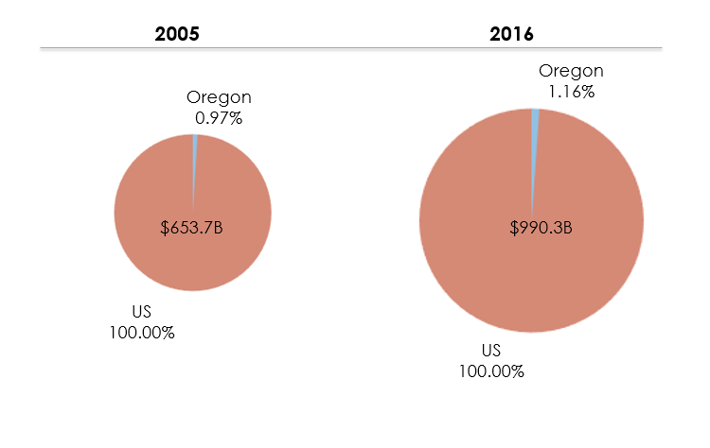
Share of Visitor Spending
Sources: US Travel Association; Dean Runyan Associates Oregon Travel Impacts 1992-2015p

Slide 8
AD ACCOUNTABILITY ROI
Increase in Visitor Spending:
Increase in State and Local Tax Revenue:
2004
$159:1
2004
$6:1
Source: Ad Accountability, 2004, 2012/13, Longwoods

Slide 9
AD ACCOUNTABILITY ROI
Increase in Visitor Spending:
Increase in State and Local Tax Revenue:
2013
$237:1
2013
$11:1
2004
$159:1
2004
$6:1
Source: Ad Accountability, 2004, 2012/13, Longwoods

Slide 13
BRAND USA PARTNERSHIP
Notes:
Partnership with Brand USA – Brand USA is to Travel Oregon as you/your DMOs are to Travel Oregon. Brand USA promotes the USA in international markets. Travel Oregon and its state partners partner on specific projects, marketing and advertising to promote Oregon internationally.
-Multi Channels
-Inspiration Guides
-Tradeshows
-Mega Fams
-Videos
-TV shows/Commercials
Video: raw cut of a culinary video that Brand USA produced that will be translated into Japanese and promoted through their channels. This was an added benefit from a Culinary Initiative in which Travel Oregon participated.

Slide 14
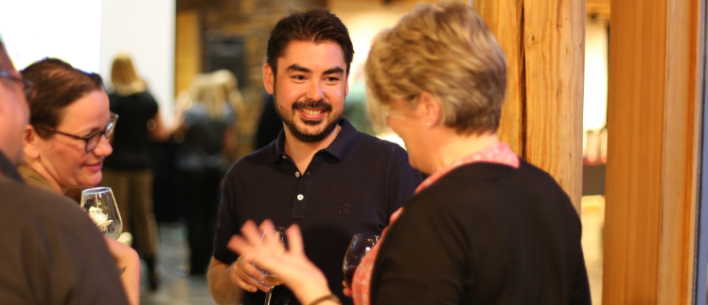
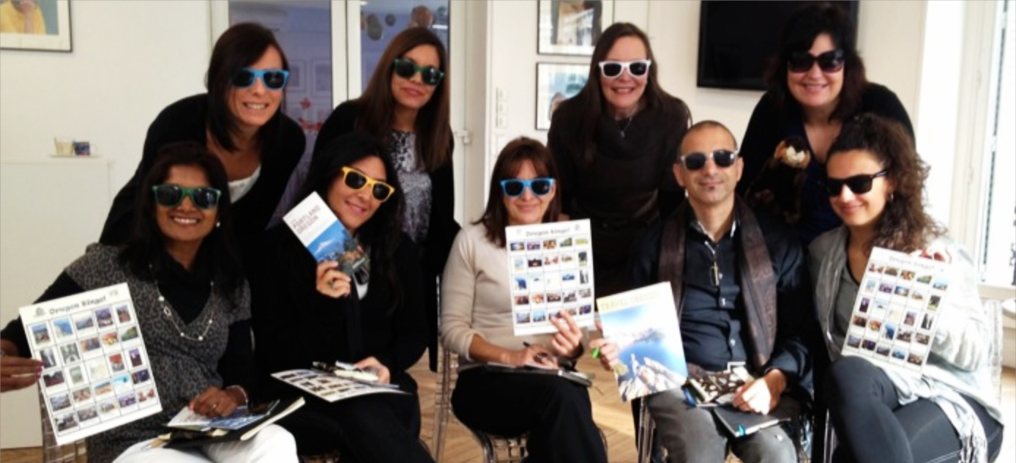
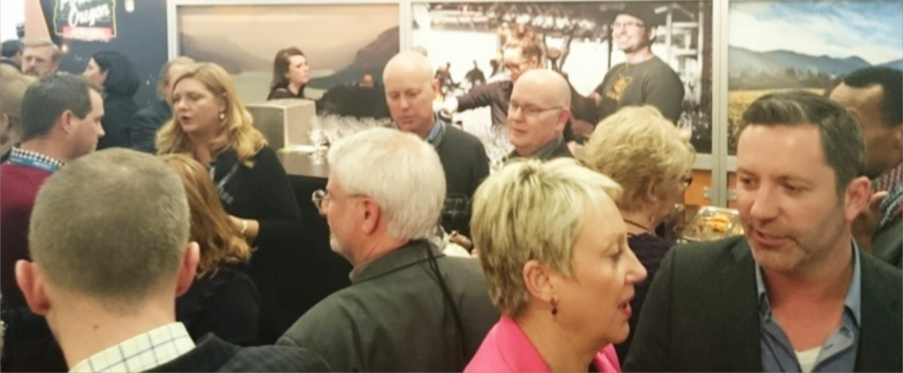
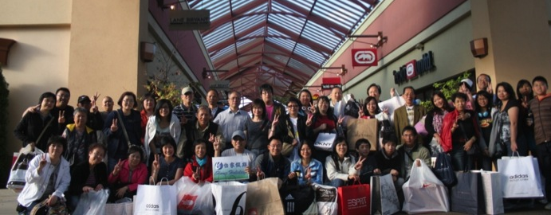
OUT IN THE FIELD
CONTRACTORS
EDUCATION
TRADESHOWS
FAM TOURS
Notes:
IMAGE 1: Top Left - Lisa Chamberlain selling Oregon to France.
In-country marketing and PR reps in 9 countries
IMAGE 2: Top Right - French Agent Training.
- Travel Agent Education
IMAGE 3: Bottom Left - ITB Tradeshow in Berlin
- Trade shows & sales missions: 33 per year
- Tour Operators
- Receptive Tour Operators
IMAGE 4: Bottom Right - Fam at Woodburn Premium Outlets
- Media & travel: trade research trips (“fams”) Connect to your DMO & RDMO…
Also:
Partnering with regional & international carriers
Printed material

Slide 15
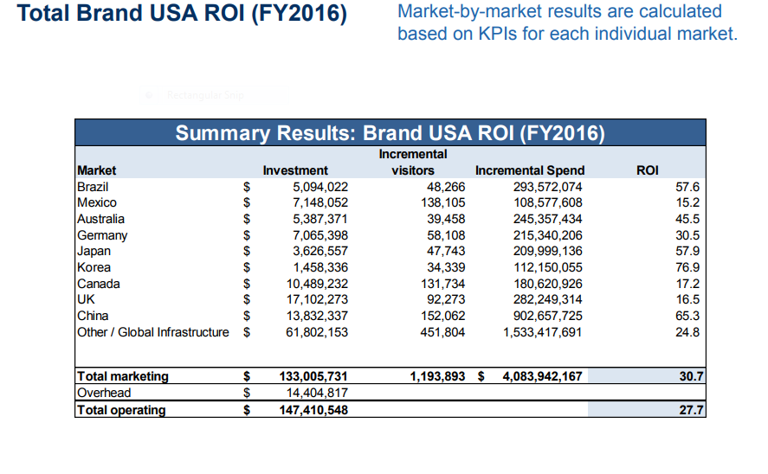
Notes:
• In 2016, each dollar of Brand USA marketing generated $30.70 of visitor spending. Including all operating overhead, Brand USA achieved an ROI of $27.70 and generated $4.1 billion in visitor spending. • Relatively high market growth and spending per visitor drove strong returns in Asia and Latin America with an average ROI of 60.0. • The average ROI remained solid, while more modest, in the mature markets of Canada and Europe. • Total visits generated tallied 1.2 million. This was 1.6% of all visitors to the US in 2016. • Incremental spending figures include spending while in the US plus transportation spending on US-flagged carriers based on BEA balance of payments data.

Slide 16
THANK YOU

Slide 18
National Travel and Tourism Office Data

