Slide 1
REMOTE ENERGY SOLUTIONS
Hon. Wally Schumann
Minister of Infrastructure
Pacific North West Economic Region Summit - July 24-27, 2017
Portland Oregon
Government of the Northwest Territories

Slide 2
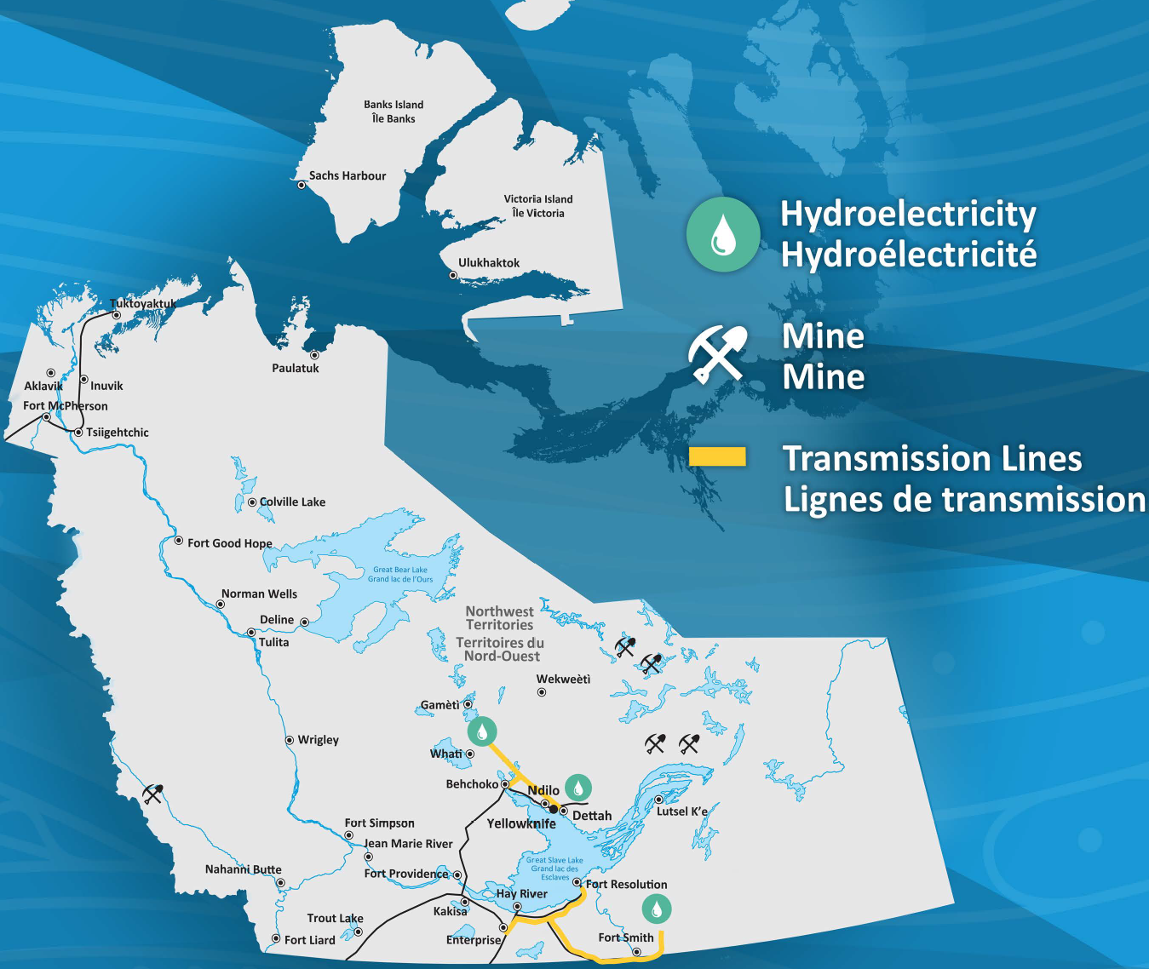
Outline
NWT overview
NWT access challenges
Reducing diesel reliance
Energy Strategy & Climate Change Strategic Framework
Notes:
As a starting point I will try to capture what the remote north really means in the context of the Northwest territories:
Northern and remote are relative terms that carry different meaning depending on where you live
I’ll provide a quick snapshot of our population, geography, our road and energy infrastructure and the reality that we have been and continue to be a resource driven economy
From there I’ll focus on a few key areas of interest for reducing diesel in our remote communities for both heating and power generation and how that work along with recent public engagement is shaping our approach to developing an NWT Energy Strategy and Climate Change Framework to the year 2030.

Slide 3
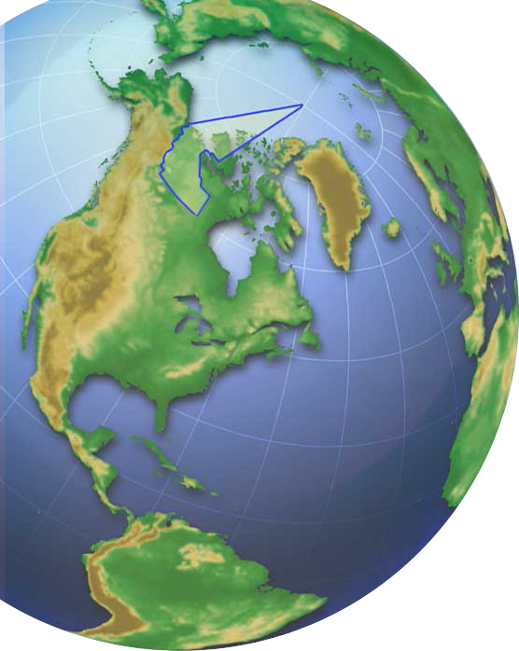
NWT Overview
44,000 residents
33 communities
few roads, transmission lines
Resource driven economy
8 hydro power communities
25 off-grid (diesel) communities
Heating from fossil fuels / biomass (wood pellets / cord wood)
Notes:
NWT Land mass – 501,932 sq. miles or 1.3 million square kilometres
5 x larger than State of Oregon - 2nd only to Alaska in terms of land area compared to all other US States
with a population of only 44,000 residents spread across 33 communities we truly are remote
We remain a largely untapped resource driven economy with incredible human and natural resources from which to draw
We have few roads and transmission lines so the cost of entry for the mining and business sectors and the cost of living for our residents is very high
Legacy hydro serves 8 communities – a direct result of our mining heritage which I will speak to in a minute
We have 25 off-grid (diesel) power systems that operate independently across the NWT
Heating is largely from fossil fuels but we are growing our reliance on biomass from wood pellets and cord wood that I will highlight later in the presentation

Slide 4
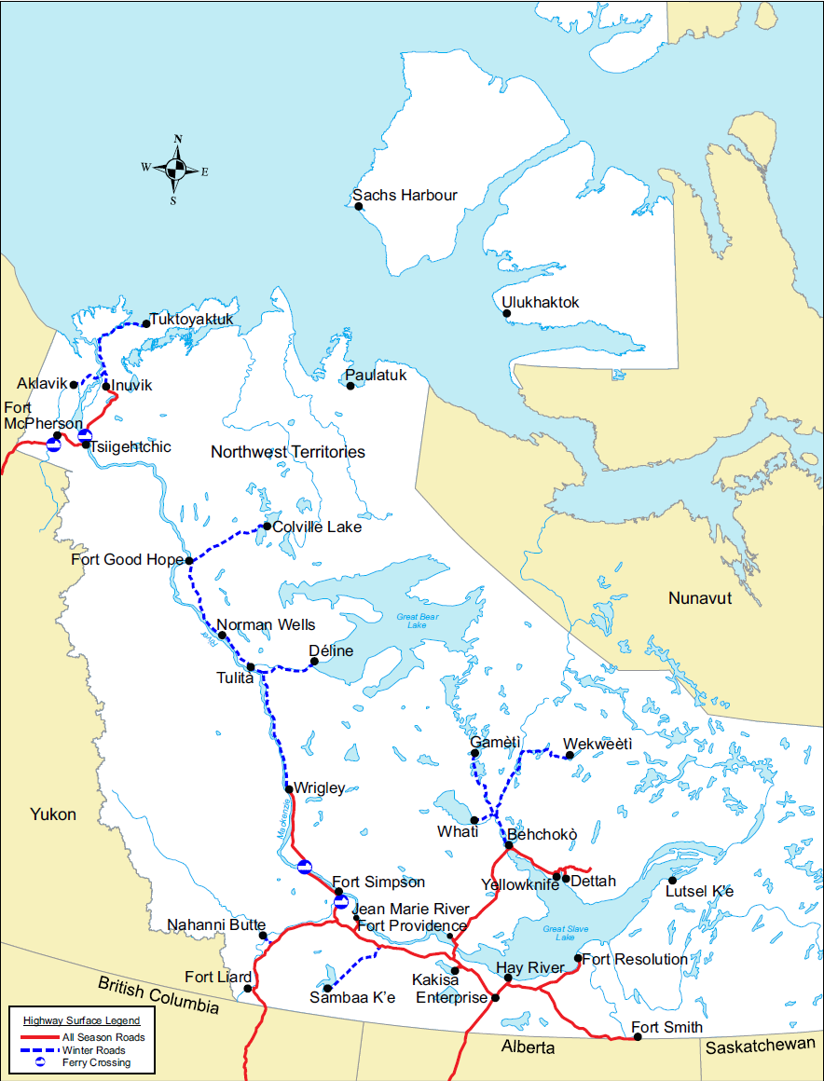
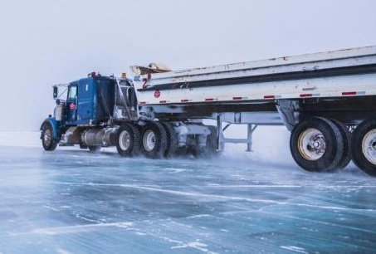
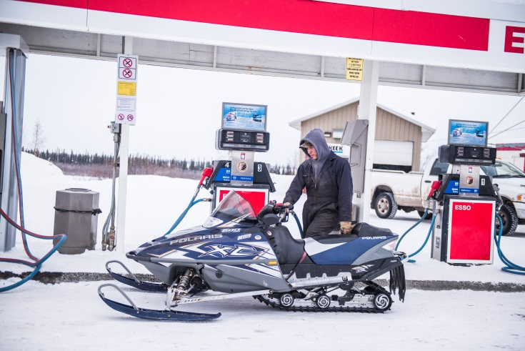
NWT Access
Notes:
33 Communities with a range of isolation constraints that add to the cost of living and doing business in the north.
19 – “All weather” road communities
10 - Winter road only (Feb-March road access)
4 - Fly-in only communities
All of our operating diamond mines and most of our prospective mining operators nemust factor winter road access into their construction and operating mine plans
For this reason, investments in transportation and energy corridors are critical to developing the vast natural resource potential pf our north.
we are working with the Government of Canada to recognize that roads and transmission lines are priorities for northern development – these are things that other parts of the developed world may take for granted.
We also must develop energy solutions that are tailored to the realities of northern and remote diesel communities.
Nonetheless, our rich and unique cultural history is a product of our relative isolation.

Slide 5
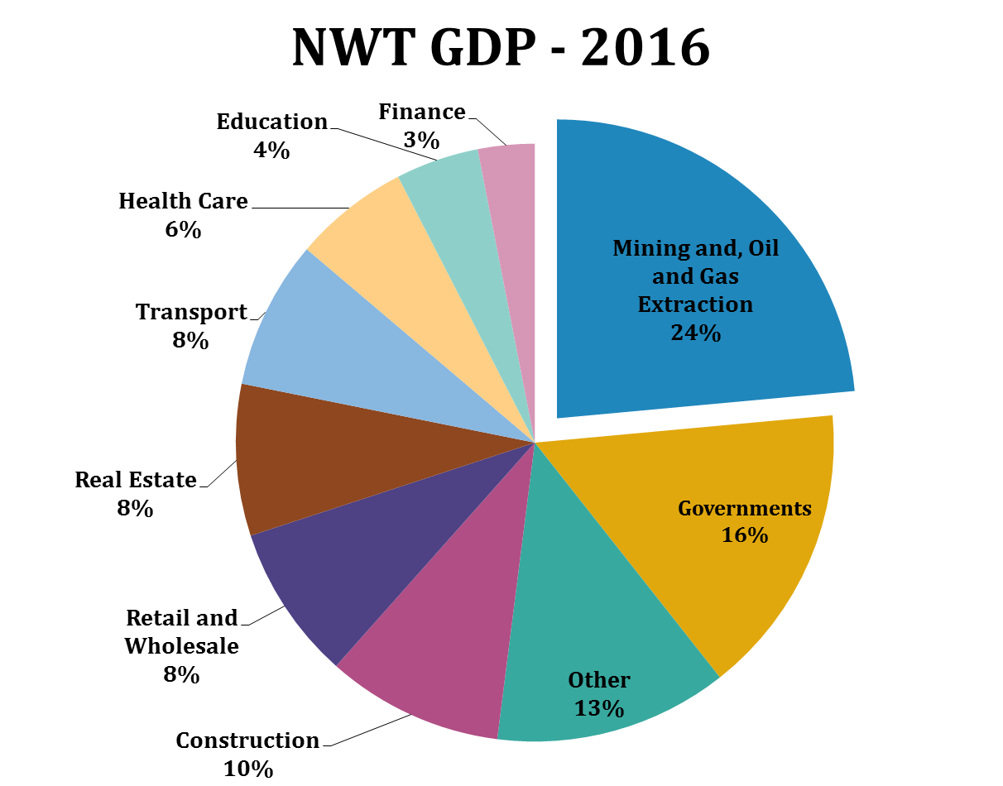
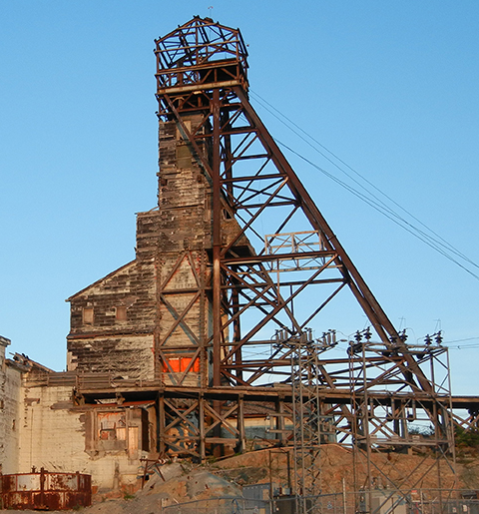
NWT Resource Economy
Notes:
Mining is a big part of our history
The NWT has been fortunate from a mining perspective as we have transitioned from gold mining starting in the 1940’s and ending in the early 2000’s to Diamond mining starting in the late 90’s and it is our hope that the diamond industry will extend beyond 2030.
Today our 3 operating diamond mines account for over 15% of our gross domestic product and Canada is the 3rd largest diamond producer in the world.
We are working with our federal counterparts to promote the development of roads and energy infrastructure in our Territory, infrastructure that would improve economic access to our plentiful natural resources. There are great possibilities for the development of precious metal, base metal and other mineral resources as well as oil and gas opportunities.
Construction and government operations play a significant role in our economy, and our tourism industry is growing quickly, with aurora viewing, adventure and eco-tourism, and world class hunting and fishing.

Slide 6
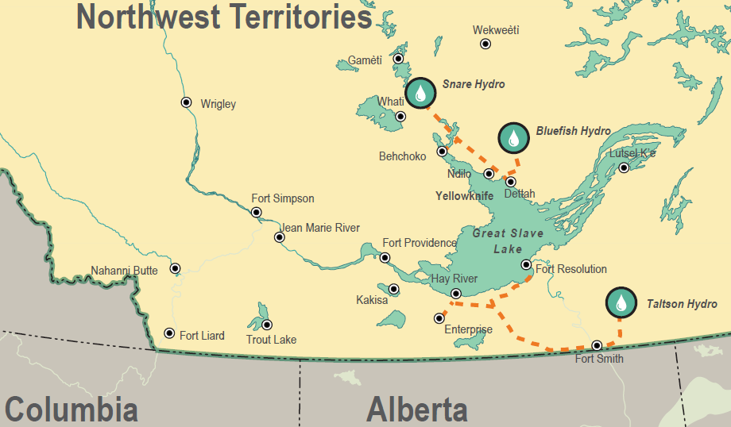
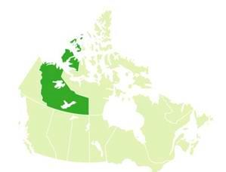
Southern NWT – Mining & Hydro Legacy
British Columbia
Alberta
Notes:
Our legacy hydro systems were a direct result of federal government investments in hydro power to support the mining industry of the 1940’s in the north slave area and in the 1960’s on the Taltson River.
Communities continue to enjoy those benefits today.
In the case of the Taltson hydro system, in the south west part of the NWT, there is significant untapped potential and we are exploring potential partnerships with our neighbors to the south in Alberta and Saskatchewan. Such a project would see the electrical transmission system of the NWT become finally connected to the North American continental electrical grid.
Grid connection to the rest of Canada would be a transformative change to the NWT’s electricity system but will require a partnership approach with first nations, power utilities and various levels of government. In the meantime we are also working to build out our existing system at a smaller scale by connecting the indigenous communities of Fort Providence and Kakisa. But the investments required are high. It may cost as much as 50 million dollars to build the power line to connect a population of 1,000 people – hence the need for partnerships.

Slide 7
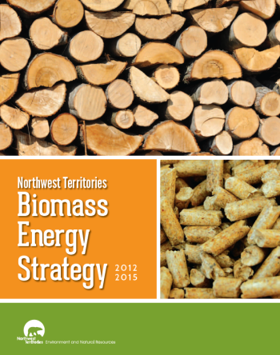
Biomass for Heating
30 biomass boilers feeding GNWT Assets installed in last 10 years
18% of total GNWT heating use
40,000 Tonnes of GHG emission reductions
GNWT supporting growing biomass heating market across NWT driven by private sector
Notes:
We are mindful that cost of living is not just about Power generation and greenhouse gas emission impacts from fossil fuel heating are a significant opportunity for northerners to address.
We are investing in wood pellet boilers across the NWT that reduce GHG emissions and dollar savings versus the diesel alternative for commercial and residential heating.
We are also testing the viability of small scale combined heat and power projects. Later this year we will complete the installation of a 25kW biomass Combined Heat and Power project that will heat and power a government warehouse in the diesel powered community of Fort Simpson.

Slide 8
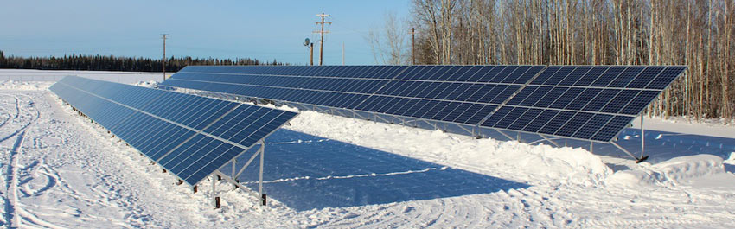
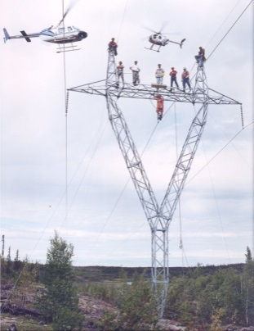
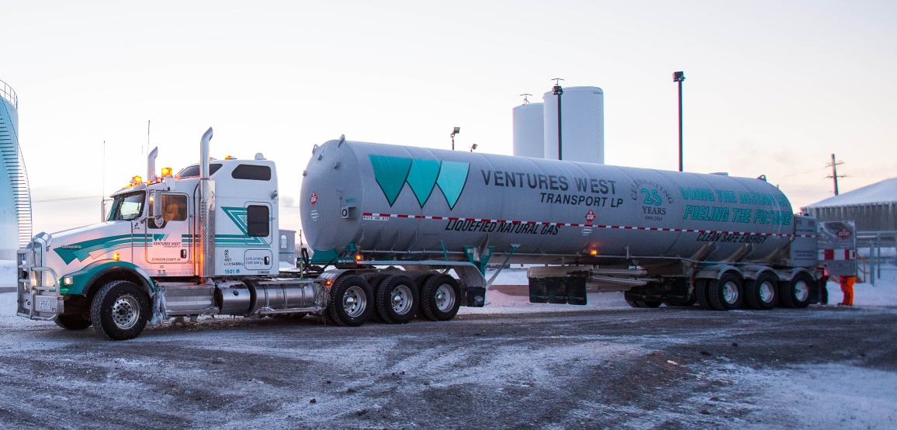
Reduce Diesel Electricity
Notes:
We are working on a number of power projects based on proven southern technologies that we are adapting to the northern environment.
Liquefied Natural Gas is successfully displacing diesel in Inuvik and we are looking at ways to apply similar solutions for other road connected communities.
We now rank second in Canada on a per capita basis for installed solar PV capacity – with 850 kW of solar power installed across the NWT.
We are also investing strategically in emerging technologies:
We are learning from our recently completed high penetration Solar / diesel project in Colville Lake that uses lithium batteries to maximize the benefits of solar energy in the community.
We are investing in a pilot project to test the benefits a variable speed generator project in Aklavik that is expected to improve the efficiency of the diesel plant and improve the integration of a new 55kW solar array.

Slide 9
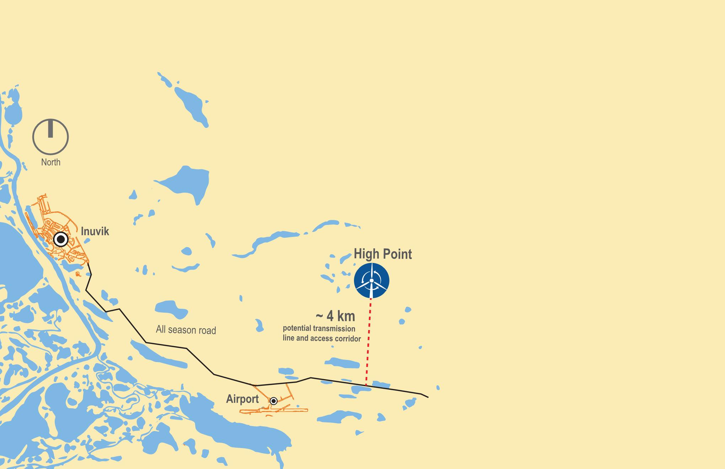
Inuvik NWT – Wind Feasibility
Inuvik
NWT’s Largest Thermal Community (3,500 people)
Phase II Feasibility underway
2-4MW wind project
4 km all season road
Transmission Line
Notes:
The Inuvik wind project is an exiting opportunity to reduce diesel consumption in our largest thermal community.
The goal is to achieve a 20-30% reduction in diesel consumption from power generation.
The community is above the arctic circle but is one of our all weather road communities.
The average load in the community is 3.2 Megawatts so this high penetration wind project would require a battery energy storage system in order to integrate significant amounts of intermittent wind power will providing stable and reliable power to the community.

Slide 10
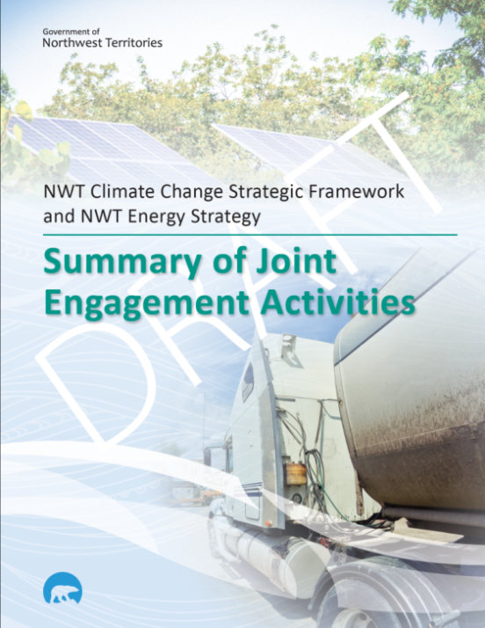
2030 NWT Energy & Climate Change Strategy
2030 Energy Strategy
GHG Emission targets
  Heating
  Transportation
  Energy Efficiency
  Electricity
Climate Change Adaptation & Mitigation Plan
Notes:
We have just concluded 6 months of engagement sessions on energy and climate change issues across the NWT and are building a Draft Energy Strategy and Climate Change Strategic framework that will guide our approach to energy and climate change related activities for the next 10 to 12 years.
We are working to develop specific GHG emission targets associated with energy use in four key areas: Heating, transportation, energy efficiency and power generation.
We are also linking our strategy to the Pan-Canadian Framework being implemented by the Government of Canada. Our Federal Government has committed to provide funding to support specific northern programs that will help make our vision of the future a reality.

Slide 11
THANK YOU!
Notes:
We are today exploring many exiting opportunities; we are blessed with a bounty of untapped natural resources, and we look to the future with great optimism.
We know that it will take time, expense and great effort to transition our energy mix to reduce the use of fossil fuels, and to adapt and plan for the growing effects of climate change.
We are committed to invest in proven and emerging technologies that will grow our economy, reduce the cost of living, and stabilize the cost of energy for communities, businesses and residents in the north.
We also recognize the progress that has been made in other PNWER jurisdictions to improve their energy situation, we appreciate that many of us face similar challenges.
I look forward to learning more at this gathering in the coming days.

