Slide 1
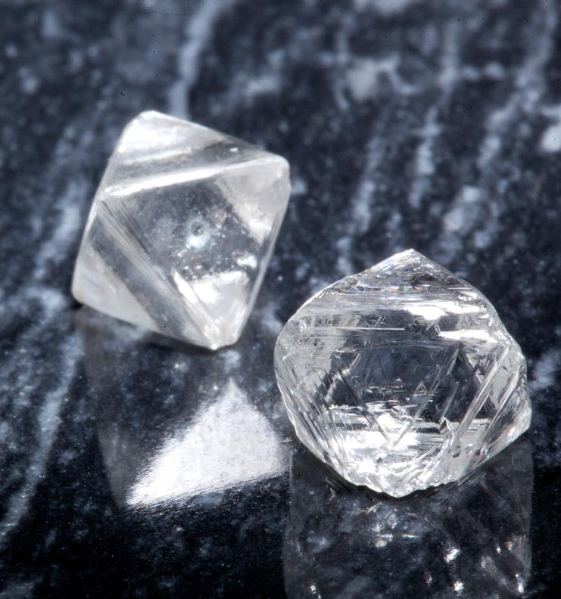
PNWER 2015
Brendan Bell,
CEO
November 17, 2015

Slide 2
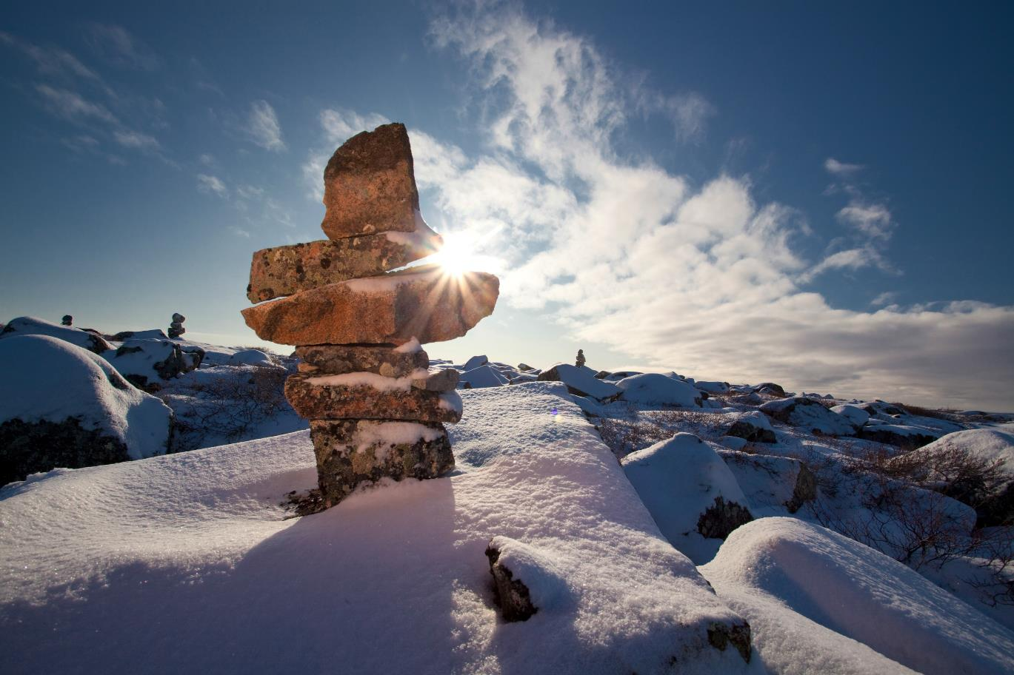

Slide 3
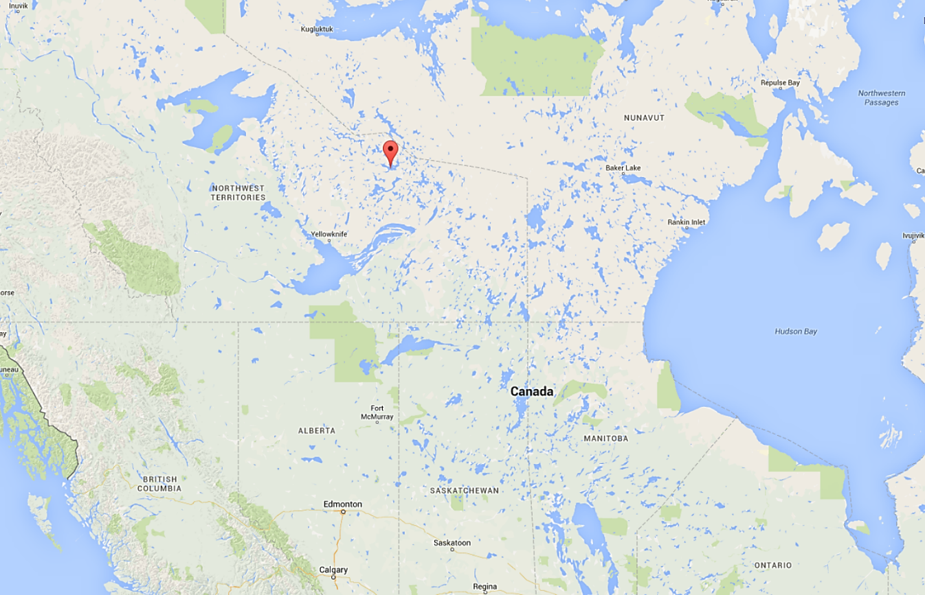
Source: Google Maps

Slide 4
1991
1998
2003
2004
2013
Ekati Production
Aber Buys Harry Winston
Discovery
Diavik Production
Dominion Diamond Buys Ekati

Slide 5
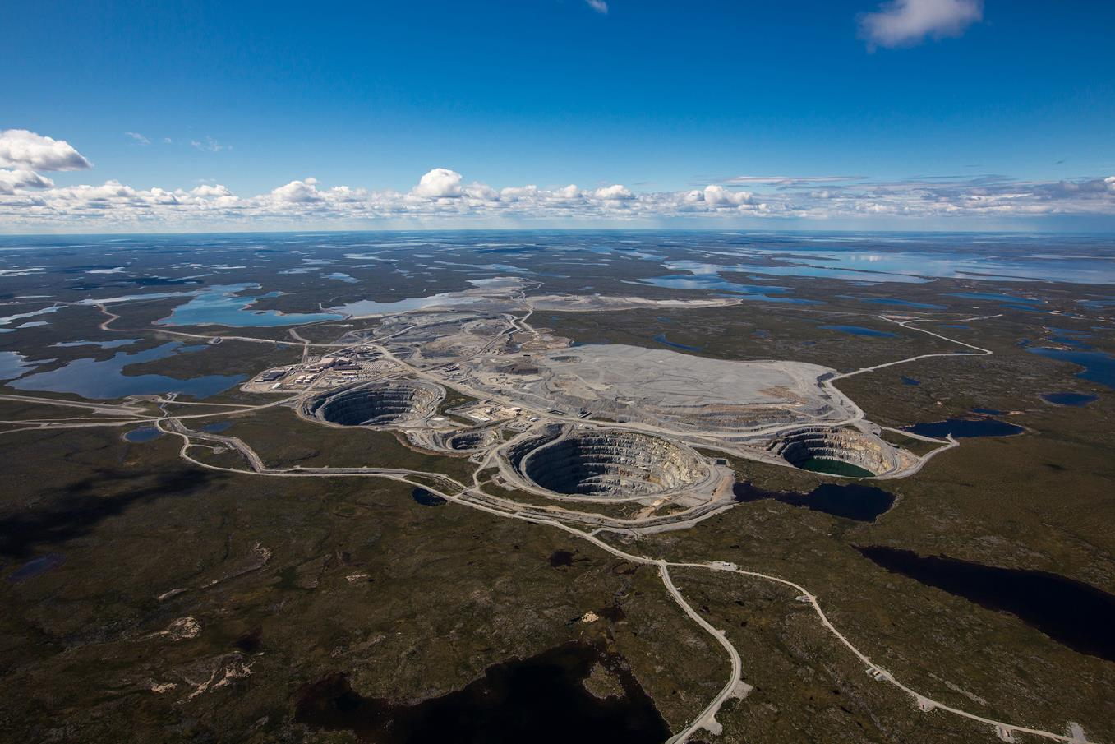
The Ekati Mine

Slide 6
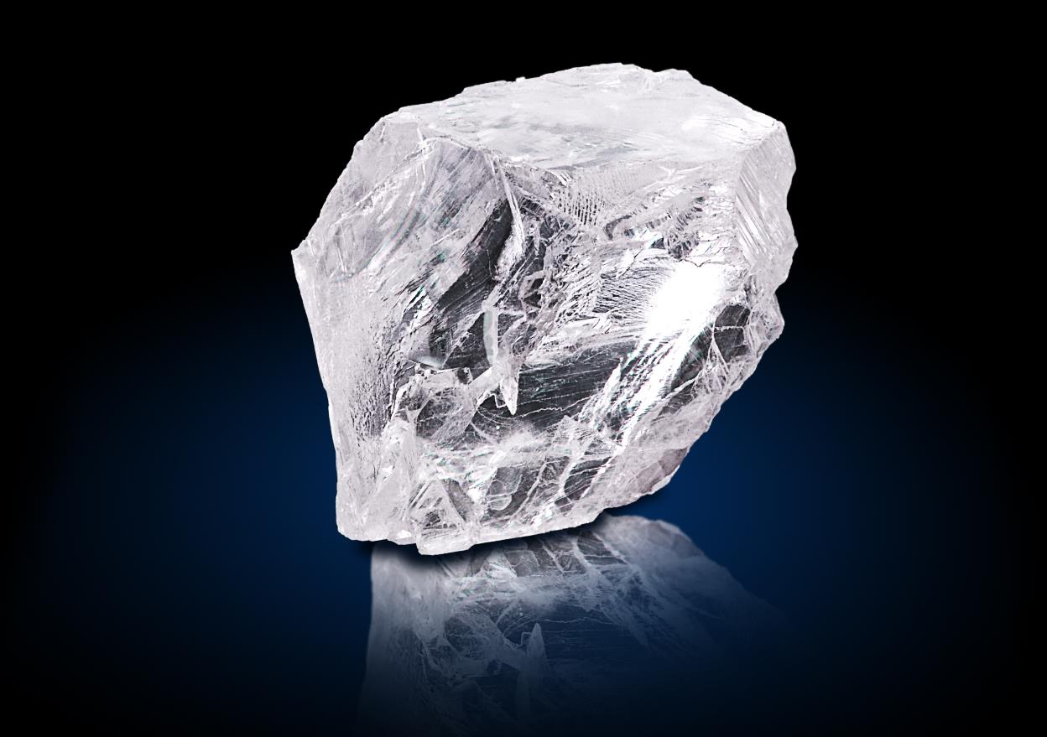
The 78-Carat Ekati Spirit

Slide 7
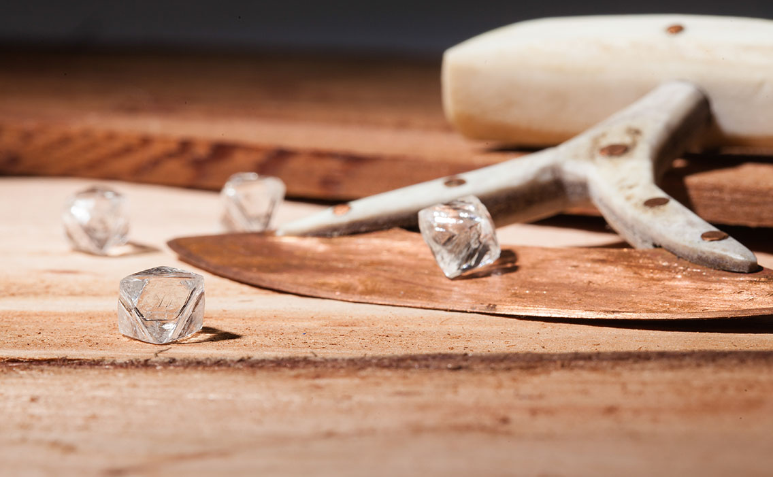

Slide 8
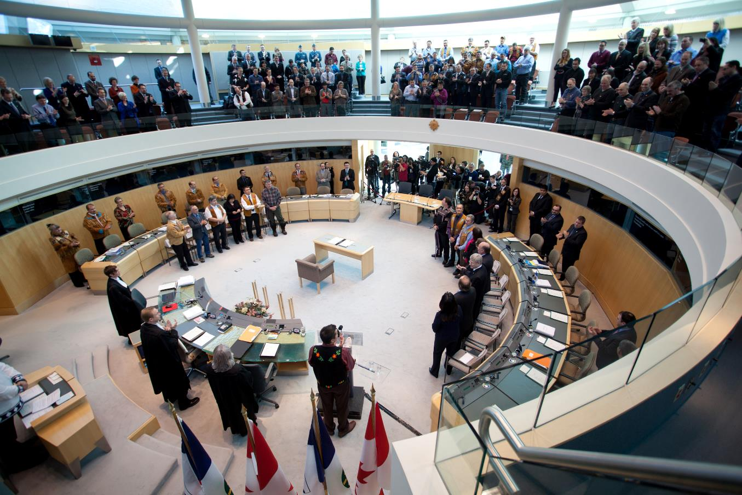
Source: GNWT
Signing of Devolution Agreement

Slide 9
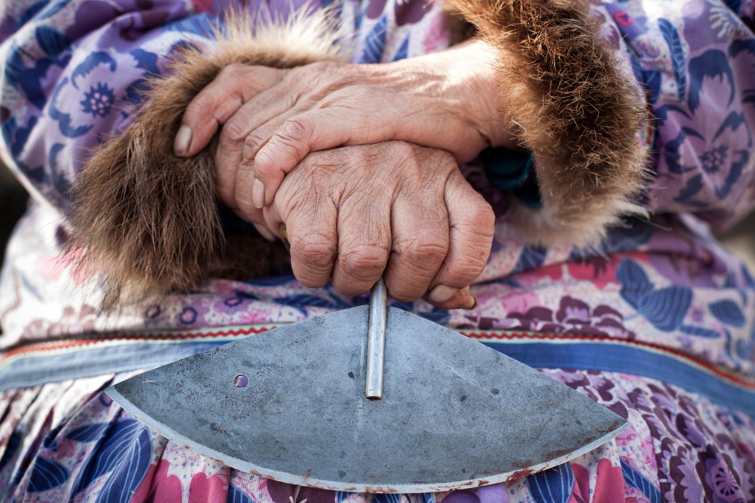

Slide 10
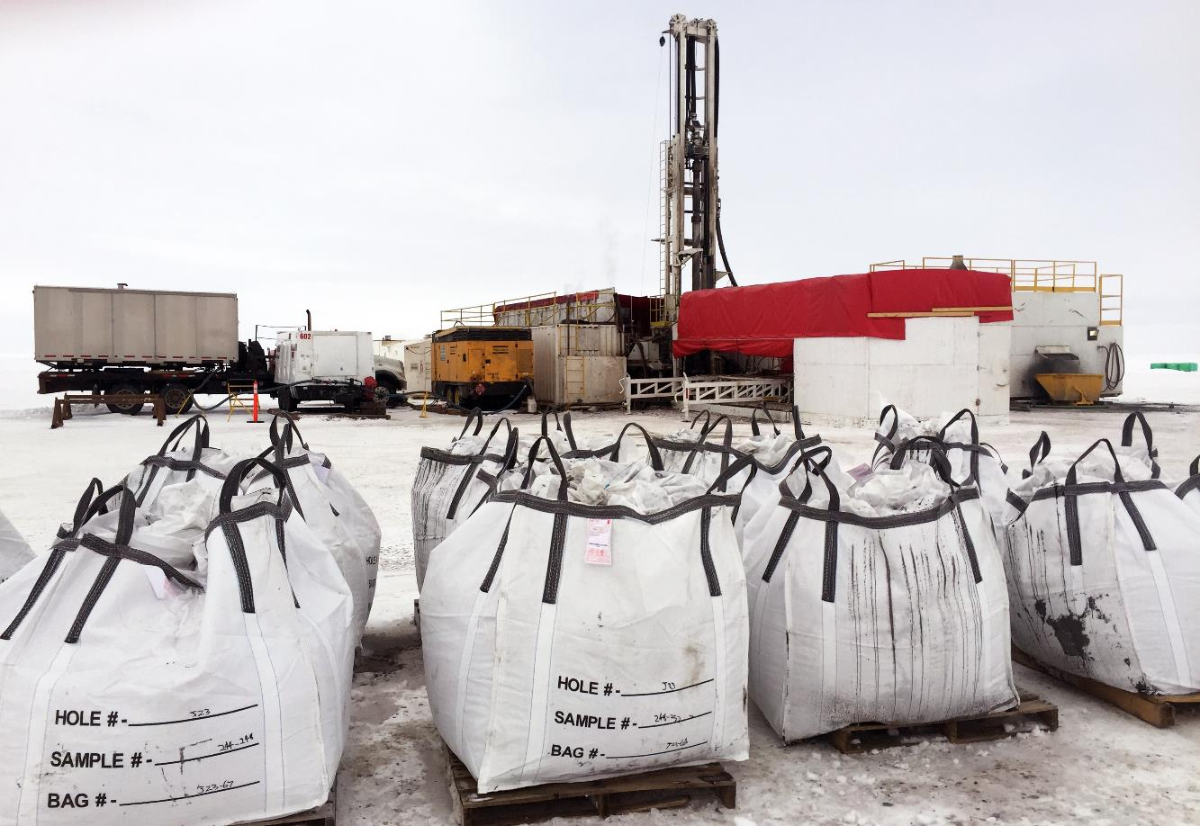
Jay Samples

Slide 11
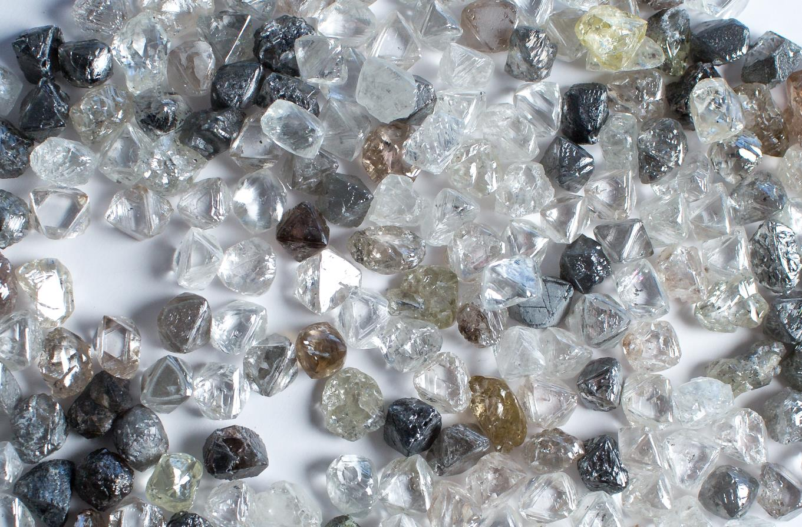

Slide 12
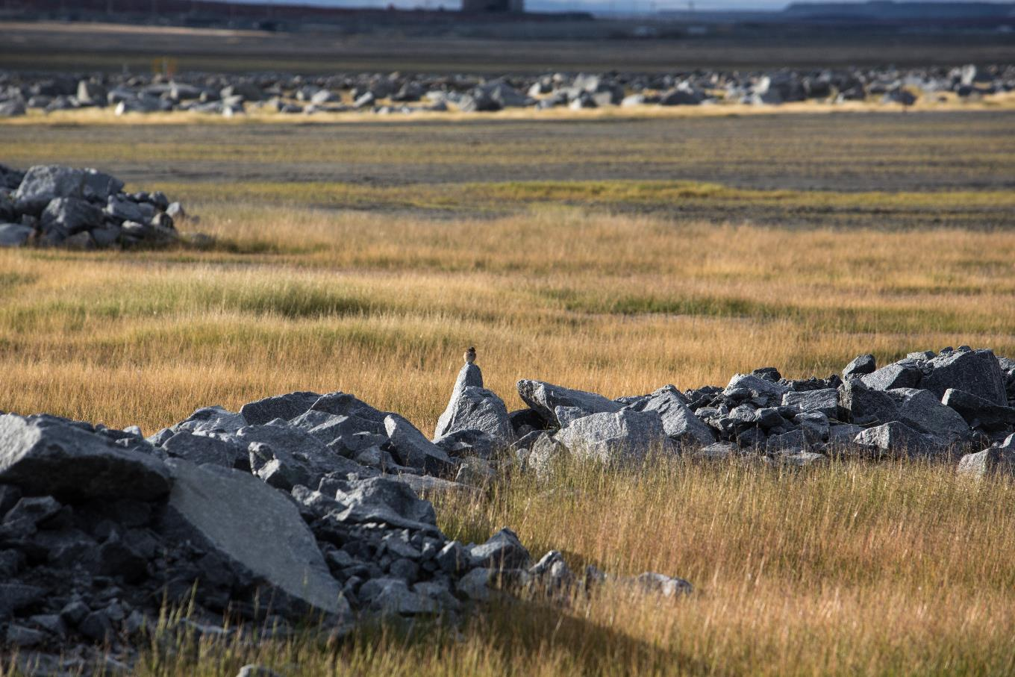
Reclamation

Slide 13
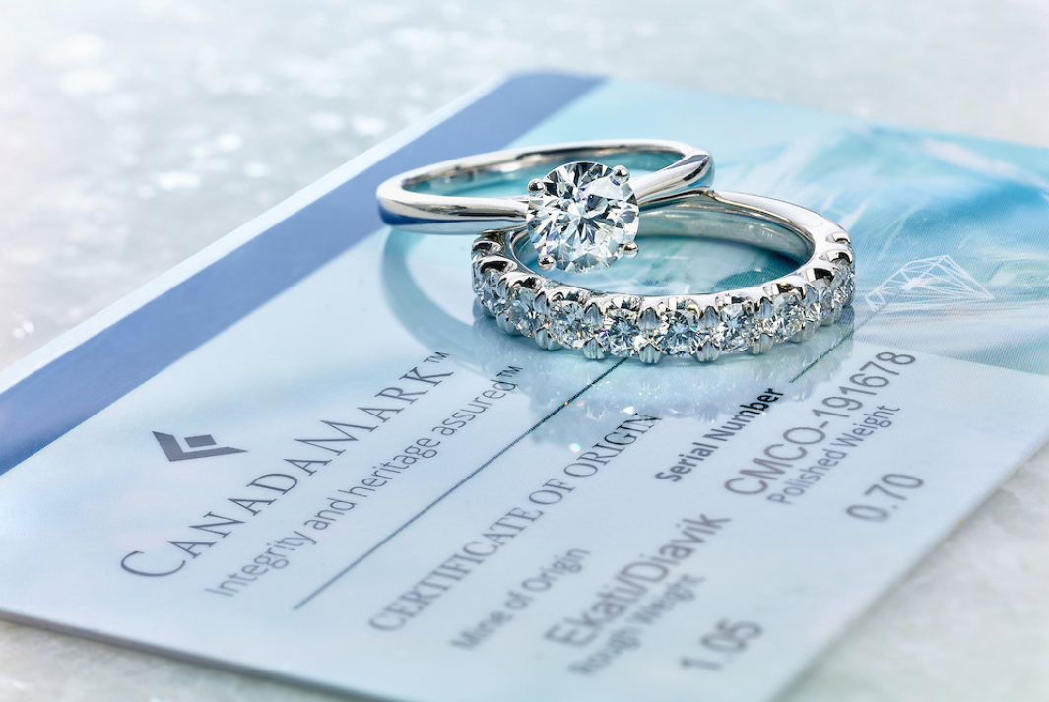

Slide 14
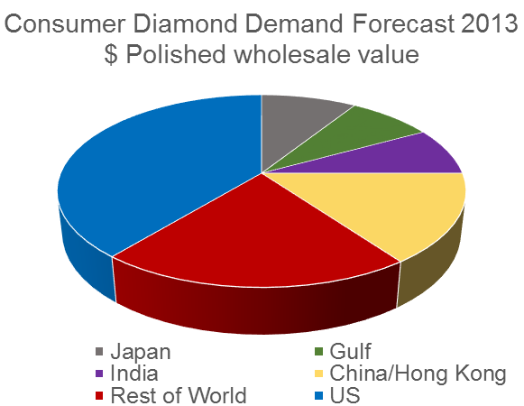
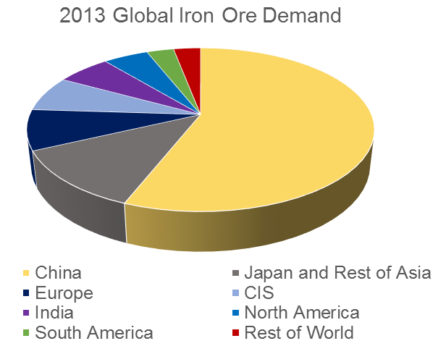
Source: DeBeers and Bloomberg
Diamond and Iron Ore Demand

Slide 15
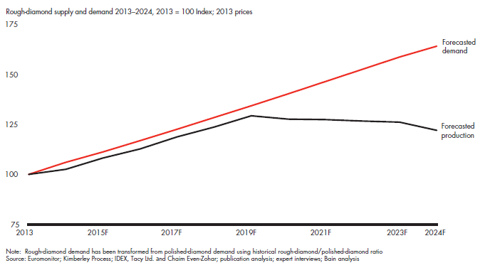
Rough Diamond Supply and Demand Forecast

Slide 16
Projected Global Rough Diamond Production

Slide 17
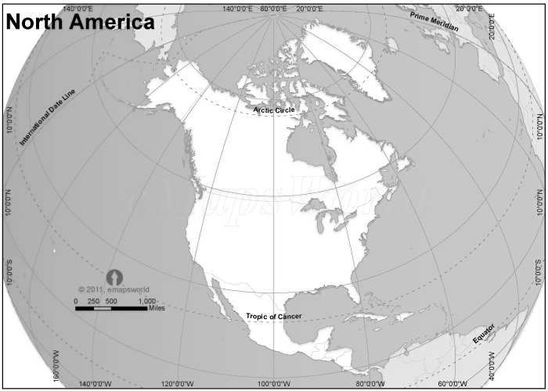
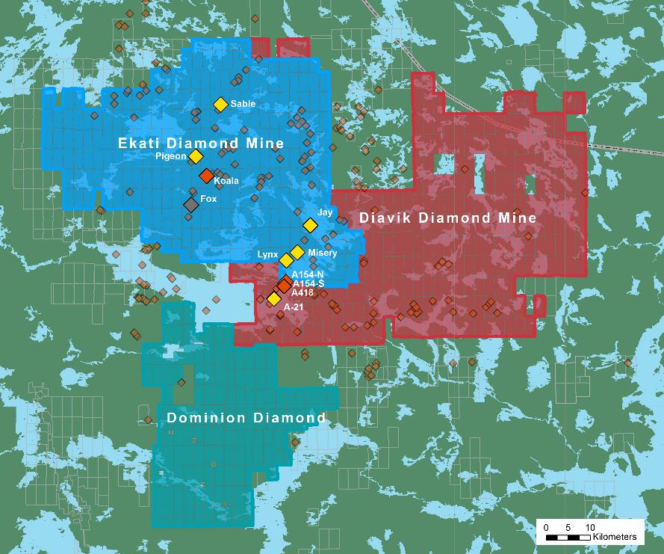

Slide 18
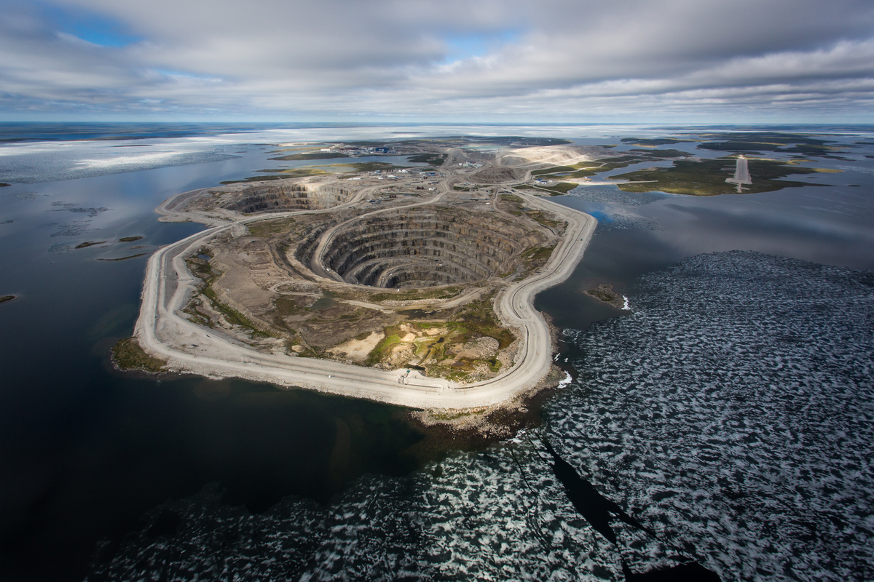
The Diavik Mine

Slide 19
